Slide 1
Model Data in Public Transportation Scoring for Prioritization
NCDOT Strategic Prioritization Office
Sarah Lee and Jason Schronce
November 5, 2019

Slide 2
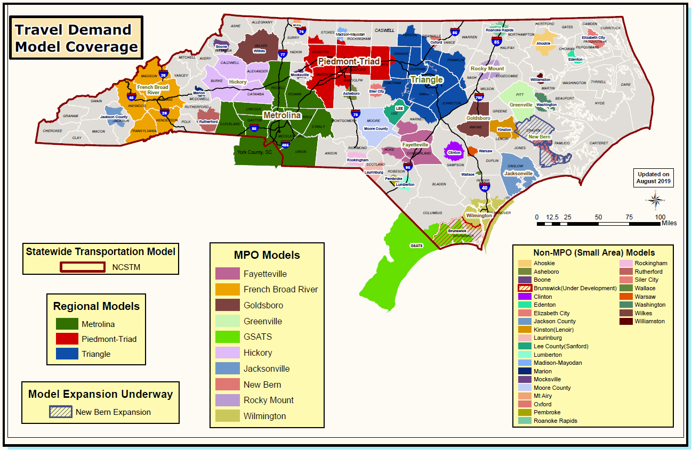
Models in NC
Transit Elements:
Triangle (CAMPO and DCHC)
Triad (Greensboro, Winston Salem, High Point, & Burlington)
Metrolina (Cabarrus-Rowan, GCL, and CRTPO)
French Board River
Fayetteville
Greenville
Wilmington

Slide 3
Public Transportation in P6.0
Project eligibility based on STI law
Minimum total project cost = $40,000 (same as P5.0)
Replacement vehicles funded through other methods
Allowed to request between 10% and 90% of total project cost (up to legislative cap)
Project entry requirements (per PTD)
 | Statewide | Regional | Division
Public Transportation | N/A | “Service spanning two or more counties and serving more than one municipality” (based on route and not provider) | “Service not included in Regional”; “Multimodal terminals and stations serving passenger transit systems” (includes all facilities)

Slide 4
Public Transportation in P6.0
STI Legislative Caps
Funding limits on Regional Impact projects:
amount of funds programmed to Public Transportation projects cannot exceed 10% of any Region’s allocation (includes commuter rail, intercity rail, and light rail)
Funding limit on light rail and commuter rail projects: total state funding for a project cannot exceed 10% of the estimated (submitted) project cost

Slide 5
Project Categories for P6.0
Projects are scored in 3 separate categories:
Mobility (Route-Specific)
Demand-Response
Facility
Project measures will be scaled within each criteria, separately within each project category
 | Mobility | Demand-Response | Facility
Impact | Scale | Scale | Scale
Demand/ Density | Scale | Scale | Scale
Efficiency | Scale | Scale | Scale
Cost Effectiveness | Scale | Scale | Scale
Notes:
Benefits of changes:
*better grouping of similar projects
*better distribution of scores with scaling

Slide 6
Specific Improvement Types
1 - Mobility (route-specific) - New Service
2 - Mobility (route-specific) - Headway Reduction
3 - Mobility (route-specific) - Extension
4 - Demand Response
5 - Facility - Passenger Station
6 - Facility - Stop/Shelter
7 - Facility - Park and Ride
8 - Facility - Administrative
9 - Facility - Maintenance

Slide 7
Project Categories for P6.0
Projects are scored in 3 separate categories:
Mobility (Route-Specific)
Demand-Response
Facility
Projects are submitted under Specific Improvement Types:
1 - Mobility (route-specific) - New Service *
2 - Mobility (route-specific) - Headway Reduction *
3 - Mobility (route-specific) - Extension *
4 - Demand Response
5 - Facility - Passenger Station *
6 - Facility - Stop/Shelter *
7 - Facility - Park and Ride *
8 - Facility - Administrative
9 - Facility - Maintenance
* = typically use modeled data
Notes:
Benefits of changes:
*better grouping of similar projects
*better distribution of scores with scaling

Slide 8
Bundling Projects
Allow across geographies
Must be kept within same SIT due to scoring setup and varying data needs for each SIT
Can be within a single municipality, or across multiple governments or transit systems (multiple governments / systems will need to provide documentation of agreement on bundling, local matches, and project management – further requirements documentation will be created by SPOT)
Bundling will be limited by project management requirements rather than geographic limitations
Any bundled project must be expected to be under one project manager/ administrative unit
Makes projects more attractive for LIPs and easier to manage/let

Slide 9
Public Transportation Scoring: Mobility
Criteria | Measure | Regional Impact (70%) | Division Needs (50%)
Impact | Number of trips affected by project | 15% | 10%
Demand/ Density | Total Trips / Service population | 20% | 10%
Efficiency | Total trips / Total revenue seat hours | 10% | 10%
Cost Effectiveness | Additional trips / (Cost to NCDOT / Lifespan of project) | 25% | 20%
Project Types:
Route-specific vehicles (new or expansion only)
Fixed guideway vehicles, fixed route vehicles, deviated fixed route vehicles
Corridors
Fixed guideway (commuter rail, intercity rail, light rail)
Bundle of vehicle + other (ex. stops / shelters, park and rides, bus pullouts)
Bus Rapid Transit (BRT)
Bus on Shoulder System (BOSS) / Busway

Slide 10
Impact
Funding Category | Criteria Weight
Statewide Mobility | N/A
Regional Impact | 15%
Division Needs | 10%
Purpose: Measure the number of trips affected by the project
Measure: New routes: Additional annual trips [project]
Headway Reduction: Additional annual trips [project] +
Relieved existing annual trips [route]
Notes: Additional Trips = 10 years in the future with new/expanded service (2029)

Slide 11
Demand / Density
Funding Category | Criteria Weight
Statewide Mobility | N/A
Regional Impact | 20%
Division Needs | 10%
Purpose: Measure the total trips on the route compared to the population serviced by the route
Measure: (Existing annual trips [route] + Additional annual trips [project]) /
Service population [route]
Notes: Additional Trips = 10 years in the future with new/expanded service (2029)
Service Population (reported to NTD):
Local Route = ¾ mile per stop
Express Route = ¾ mile per stop
(5 mile per park & ride)
(Express Route = No complementary ADA paratransit)

Slide 12
Efficiency
Funding Category | Criteria Weight
Statewide Mobility | N/A
Regional Impact | 10%
Division Needs | 10%
Purpose: Measure the total trips on the route with the project in place compared to the total revenue seat hours on the route with the project in place
Measure: (Existing annual trips [route] + Additional annual trips [project])
(Existing annual rev. hours [route] + Additional annual rev. hours [project]) x
(Existing seats [route SUM] + Additional seats [project SUM])
Notes: Additional Trips = 10 years in the future with new/expanded service (2029)

Slide 13
Cost Effectiveness
Funding Category | Criteria Weight
Statewide Mobility | N/A
Regional Impact | 25%
Division Needs | 20%
Purpose: Measure the additional trips generated by the project compared to the annualized cost to NCDOT
Measure: Additional annual trips [project] /
(Cost to NCDOT / Lifespan of project)
Notes: Additional Trips = 10 years in the future with new/expanded service (2029)

Slide 14
Public Transportation Scoring: Demand Response
Criteria | Measure | Regional Impact (70%) | Division Needs (50%)
Impact | Number of trips affected by project | 10% | 10%
Demand/ Density | Total hours with the project in place / Service population | 20% | 15%
Efficiency | Vehicle Utilization Ratio | 15% | 10%
Cost Effectiveness | Additional trips / (Cost to NCDOT / Lifespan of project) | 25% | 15%
Project Types:
Demand Response vehicles (expansion only)
No facilities – either submit Demand Response facilities under Facility category or under Mobility category if bundled with a vehicle

Slide 15
Impact
Funding Category | Criteria Weight
Statewide Mobility | N/A
Regional Impact | 10%
Division Needs | 10%
Purpose: Measure the number of trips affected (generated) by the project
Measure: Additional annual trips [project]
Notes: Additional Trips = 10 years in the future with new/expanded service (2029)

Slide 16
Demand / Density
Funding Category | Criteria Weight
Statewide Mobility | N/A
Regional Impact | 20%
Division Needs | 15%
Purpose: Measure the total hours of the system compared to the population serviced by the system
Measure: (Existing annual hours [system] + Additional annual hours [project]) /
Service population [system]
Notes: Additional Hours = 10 years in the future with new/expanded service (2029)
Service Population = county areas not served by fixed routes (3/4 of mile within fixed route)

Slide 17
Efficiency
Funding Category | Criteria Weight
Statewide Mobility | N/A
Regional Impact | 15%
Division Needs | 10%
Purpose: Measure the utilization ratio of the system
Measure: Number of vehicles in maximum service /
Number of vehicles in total fleet

Slide 18
Cost Effectiveness
Funding Category | Criteria Weight
Statewide Mobility | N/A
Regional Impact | 25%
Division Needs | 15%
Purpose: Measure the additional trips generated by the project compared to the annualized cost to NCDOT
Measure: Additional annual trips [project] /
(Cost to NCDOT / Lifespan of project)
Notes: Additional Trips = 10 years in the future with new/expanded service (2029)

Slide 19
Public Transportation Scoring: Facilities
Criteria | Measure | Division Needs (50%)
Impact | Number of trips affected by project | 15%
Demand/ Density | Ridership Growth Trend for the Previous 5 Years | 10%
Efficiency | Efficiency Score | 10%
Cost Effectiveness | Additional trips / (Cost to NCDOT / Lifespan of project) | 15%
Project Types:
Passenger stations
Individual or bundled stops/shelters
Individual or bundled park and ride lots
Administrative / Maintenance buildings

Slide 20
Impact
Funding Category | Criteria Weight
Statewide Mobility | N/A
Regional Impact | 20%
Division Needs | 15%
Purpose: Measure the number of trips affected (generated) by the project
Measure: Additional annual trips [project]
Notes: Additional Trips = 10 years in the future with project (2029)
Admin/Maint facilities: data converted into trips

Slide 21
Demand / Density
Funding Category | Criteria Weight
Statewide Mobility | N/A
Regional Impact | 10%
Division Needs | 10%
Purpose: Measure the growth in ridership for the system over the previous 5 years
Measure: Ridership Growth Trend for the Previous 5 Years [system]

Slide 22
Efficiency
Funding Category | Criteria Weight
Statewide Mobility | N/A
Regional Impact | 15%
Division Needs | 10%
Purpose: Measure the efficiency of the result of the project
Measure: Passenger stations, stops/shelters, park and rides: Total annual trips at the facility with the project in place
(Existing annual trips [facility] + Additional annual trips [project])
Administrative facilities: Square footage per total FTE (includes operators)
Maintenance facilities: Number of vehicles per bay at planned fleet size
Notes: Utilizes lookup table
Passenger facilities: higher trips = higher points
Admin/Maint facilities: optimum value = highest points
Additional Trips = 10 years in the future with project (2029)

Slide 23
Efficiency Score (Passenger Facilities)
Stops/Shelters | NEW Station or Park and Ride | EXPANSION Station or Park and Ride | Points
Total Annual Trips with project (per shelter) [facility(ies)] | Total Annual Trips with project [facility] | Total Annual Trips with project [facility]
>20,000 | >50,000 | >100,000 | 6
15,001 - 20,000 | 37,501 - 50,000 | 75,001 - 100,000 | 5
10,001 - 15,000 | 25,001 - 37,500 | 50,001 - 75,000 | 4
5,001 - 10,000 | 12,501 - 25,000 | 25,001 - 50,000 | 3
1 - 5000 | 1 - 12,500 | 1 - 25,000 | 2
0 | 0 | 0 | 1
Values based on future conditions (with project)
Notes:
*250

Slide 24
Efficiency Score (Administrative or Maintenance Facilities)
Administrative Facility | Maintenance Facility | Points
Sq.Ft. per total FTE (includes operators) [facility] | Vehicles per bay at planned fleet size [facility]
150 - 350 | 8 - 10 | 6
75 - 149 or 351 - 425 | 6 - 7.9 or 10.1 - 12 | 4
<75 or >425 | <6 or >12 | 2
Values based on future conditions (with project)
Highest score is based on optimum values
Notes:
*250

Slide 25
Cost Effectiveness
Funding Category | Criteria Weight
Statewide Mobility | N/A
Regional Impact | 25%
Division Needs | 15%
Purpose: Measure the additional trips generated by the project compared to the annualized cost to NCDOT
Measure: Additional annual trips [project] /
(Cost to NCDOT / Lifespan of project)
Notes: Additional Trips = 10 years in the future with project (2029)
Admin/Maint facilities: data converted into trips

Slide 26
Model Data in P5.0
Models used for trip data on projects within areas with regional models with transit elements
Prioritization scoring uses annual trips, but models use daily trips
Coordination meetings on model data brought to light that transit systems have different numbers of operating days
→ Different methods of annualizing daily trip numbers for Prioritization scoring
Consistency seemed best, so project submitters were asked to provide either daily trips or annualization factors they used
Consistent annualization factor of 260 was then used with daily trips to derive new values for annual trips for Prioritization scoring
Process was applied to all project types (Mobility, Demand Response, and Facilities) for modeled and non-modeled data

Slide 27
Model Data in P5.0
Benefit = projects were only submitted from one regional model
To ensure consistency, multiple meetings were held between CAMPO, DCHC, and TJCOG
Goal = consistent inputs that ensured results were calculated consistently
Also incorporated a third party review of input files to verify consistency
Issues with this process:
Data collection – timing of coordination meant additional data was requested via email
Communication of desired data and definition of daily vs. annual
Different methods of obtaining and projecting data for scoring – modeled vs. non-modeled

Slide 28
Model Data in P6.0
Intent of Transit scoring data is to be as accurate as possible, and not penalize or reward unnecessarily
Decided to no longer use a common annualization factor
Scoring will utilize the annual numbers as submitted by each system/project (based on each system’s actual number of operating days)

Slide 29
Model Data in P6.0
Concern = will likely have projects submitted from multiple regional models
In need of feedback from subject matter experts → is consistency possible for inputs/results across different models?
Discussion points:
What should be consistent between models vs. not? (what to focus on or not)
Off-model data vs. on-model?
How much better is the Transit growth data from the model vs. basic projections? (what does it track?) (i.e. is using the model better?)
Is SE growth data from the model a better proxy than previous 5 years?

Slide 30
Next Steps
Meet with organizations that are potentially submitting P6.0 projects that will use Transit model data
Ideas for P7.0 Transit scoring?

Slide 31
Contact Information
Jason Schronce, P.E. SPOT Manager Prioritization Office (SPOT) (919) 707-4646 jschronce@ncdot.gov | Sarah E. Lee Prioritization Office (SPOT) Non-Highway Modes (919) 707-4742 selee@ncdot.gov | Austin Chamberlain Prioritization Office (SPOT) TOP3s / GIS Support (919) 707-4650 sachamberlain@ncdot.gov | Justin Green, P.E. Prioritization Office (SPOT) Highway Mode (919) 707-4613 jdgreen@ncdot.gov
https://www.ncdot.gov/sti
spot@ncdot.gov (Jason, Sarah, Austin, Justin)

